Slide 1
Capstone Project
Final presentation

Slide 2
Business problem
Gym group willing to open a new gym in Madrid
Target group is people aged between 20 and 39 years and high incomes
Which neighborhood is the best?

Slide 3
Data
District and neighborhood names from Madrid
Population data
Income data
Source : https://www.madrid.es/
Geographical data
Source : https://www.123coordenadas.com

Slide 4
Methodology
Obtain data
Join data in a single data frame
Get venues in Madrid neighborhoods
Obtain gyms
Analyze type of gyms
Group gyms by neighborhood
Prepare dataframe for classification
Normalize data
Cluster neighborhoods
Visualize resulting clusters
Analyze clusters

Slide 5
Results
 | Cluster 1 | Cluster 2 | Cluster 3 | Cluster 4 | Mean
Gym count | 19 | 30 | 32 | 38 | 29,75
Income mean | 19.834,00 € | 22.082,00 € | 12.353,00 € | 14.073,00 € | 17.085,5 €
Population mean | 40.389 | 33.905 | 27.967 | 52.296 | 38.639,25
Population/gyms rate | 2.125,73 | 1.130,16 | 873,96 | 1.376,21 | 1.376,52

Slide 6
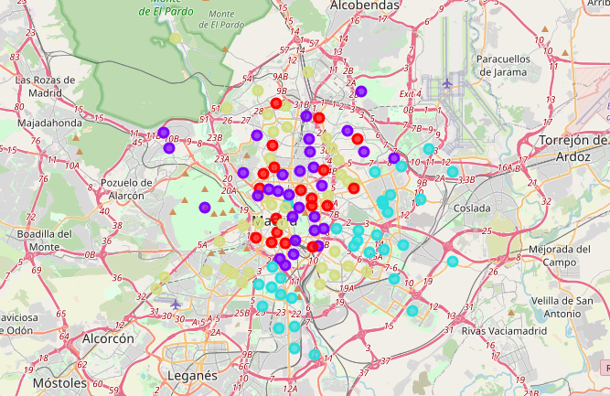
Results

Slide 7
Discussion
The Population/gyms rate of Cluster 1 is the highest of all clusters, which means that there are few gyms for the volume of people in those neighborhoods.
The average income of Cluster 1 is above Madrid mean, which means that there could be more potential customers with good salaries in these areas.
The population mean of Cluster 1 is above Madrid mean, which means that these neighborhoods are well populated.

Slide 8
Discussion
The best locations to open the gym are:
Hood Number | Hood | Neighborhood | Population | Income | Gyms
4 | SALAMANCA | CASTELLANA | 38.235,68 | 24683 | 2.0
4 | SALAMANCA | GOYA | 38.235,68 | 24683 | 2.0
7 | CHAMBERI | GAZTAMBIDE | 37.669,28 | 22897 | 2.0
3 | RETIRO | ADELFAS | 26.465,80 | 21598 | 2.0
16 | HORTALEZA | CANILLAS | 41.029,49 | 18620 | 2.0
16 | HORTALEZA | APOSTOL SANTIAGO | 41.029,49 | 18620 | 2.0

